Slide 1
EC_food presentation
Naoki Ito
Akira Sato
Takashi Kawashima
Shun Yamamoto
Notes:
Let's start ec_food presentation from Ito, Sato, Yamamoto and Kawashima
Our presentation is mainly divided into 4 parts.
First one is team introduction.
Second is from planning to development.
This part, we explain about the difference between conventional and our system
Third one is demonstration.
Last is experiments and presentation summary.

Slide 2
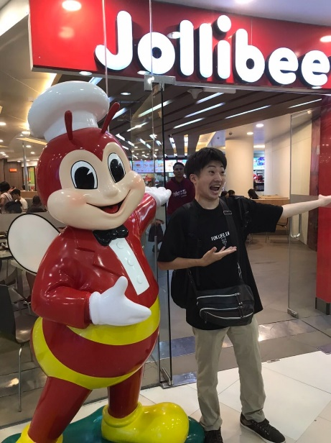

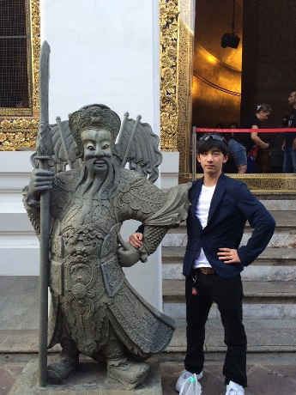

Team introduction
Front end
Naoki Ito
Front end
Akira Sato
Back end
Takashi Kawashima
Back end
Shun Yamamoto
Notes:
Our team is consist of 4 people.
First, he is "なおきいとう". we usually call him "いとなお".
He handled front end and top page.
And a day before yesterday he had a stomachache and skipped a class.
plus his wallet was stolen in a casino.
Second, he is "あきらさとう".
He handled front end and result page.
Third, he is "しゅん山本".
He handled back end and things about database.
He is a reliable person who can plan a trip.
So yesterday a gay expressed his feelings for him.
Last, I am "崇川島".
I handled back end and things about scraping and API.
I'm the only person in rakuten losing the money at the casino.
our team is such a member.

Slide 3


Abstract
Theme
Create a prototype of website that you can find products in a shortest way
What's the problem about food
User can't buy the ingredient soon when we view the recipe cite.
Solution
Make the system having a connection to buy immediately between recipe and Rakuten ichiba
Profits
User : Easy to buy ingredients for cooking
Rakuten : Increasing the chance to buy in rakuten
You can't buy directly
Notes:
First of all, I'll explain the abstract of our plan.
About overall theme is "create a ...".
Next, What's the problem about food.
About this, we think "User can't buy the ingredient..."
To solve the problem, "We make the system having a connection to buy ..."
Profits from this has 2 aspects
First is user, user's profit is "easy to buy..."
Second is Rakuten, Rakuten's profit is increasing the chance to buy from rakuten.

Slide 4
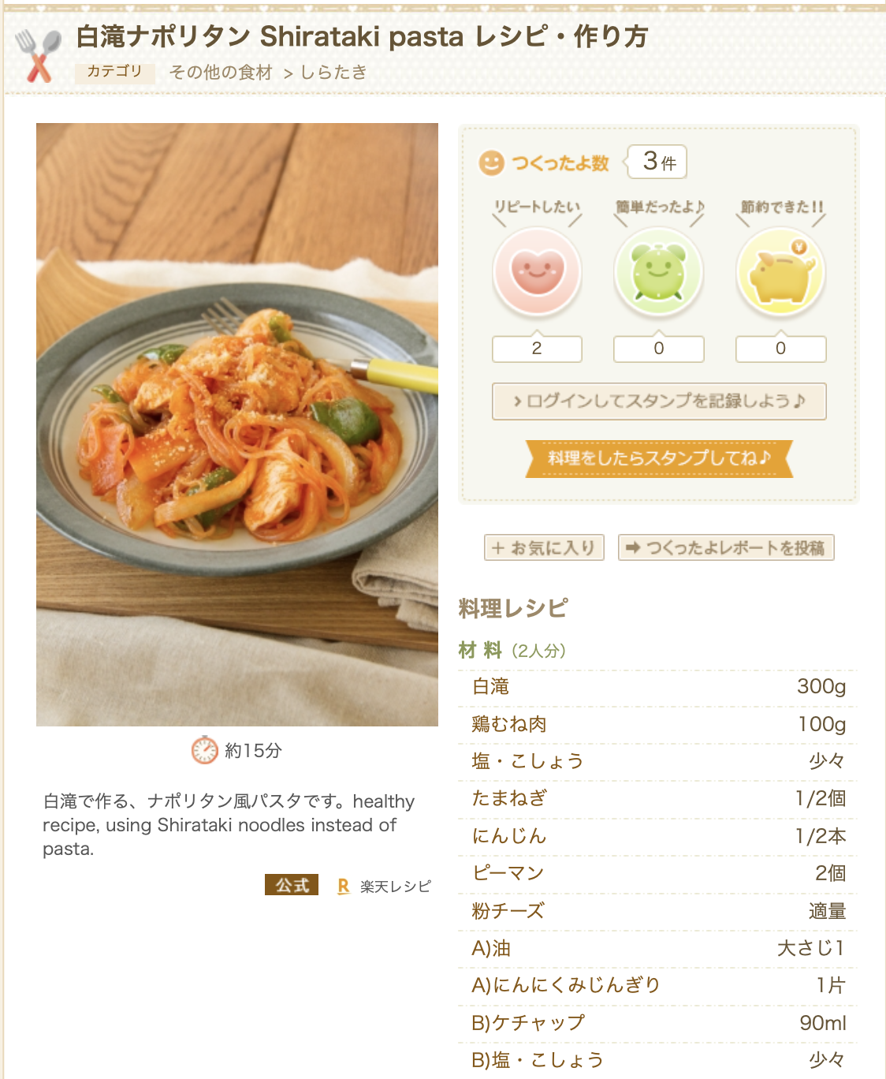
Problem
User can't buy directly
User
Traveling some sites is troublesome
Forget to buy ingredients
Rakuten
It is bought at Amazon and other online supermarkets
Notes:
From now I'll explain the problem about food.
Left figure is rakuten recipe's dish.
This has some ingredients decided by recipe user to make the dish.
In this case shirataki pasta.
Current system, user cannot buy directly from this site even so user want these ingredients.
Because of that, there are some problems
about user, "traveling some sites..." and "forget to buy"
This is the causes that take time to purchase.
and about rakuten "it is ..." this is lost opportunity to increase income.

Slide 5
Challenges
Our Challenge
To make a connection between recipe and Rakuten ICHIBA
Notes:
So our challenge is to make a connection between recipe and rakuten ichiba.
As a result, the problem mentioned before is solved and we can solve the overall theme.
Moreover we are going to show speed test result from viewing site to buy all ingredients
Next is comaparison between conventional and our system.

Slide 6

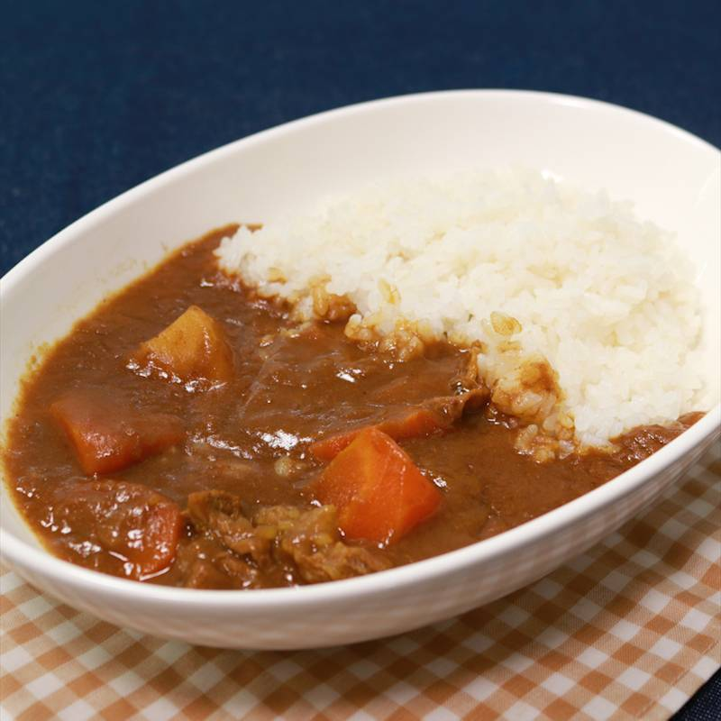




Conventional
“meat”
“curry”
“potato”
n
Purchase
・・・
①
EC site
②×n
search
Notes:
従来の楽天レシピと楽天市場を使用して食材を購入する場合、まず作りたい料理から必要食材を考え、食材の数だけ検索を行う必要あり
If a user has a dish he wants to make and wants to buy ingredients, user has to list the necessary ingredients from the dishes he wants to make.
If he wants to make a curry, he will need meat, potato, and so on.
Then, he has to search ingredient several times. Search for meat and put it in the cart, search for potato, put it in the cart… like this
After that much process, he can purchase ingredients. It takes time if there are many necessary ingredients.

Slide 7
Our System
Our Site
“meat”
①
“potato”
“curry”
・・・
Purchase
Notes:
一方で私たちのシステムを使用した場合、料理から食材がリストアップされるので検索する必要無し
On the other hand, when using our system, Just input the dish name, our website lists necessary ingredients. So there is no need to search several times. and we can buy merchandise directly from our website.
It means we can skip the phase of “thinking about ingredients from the name of the dish user wants to make”.
It is useful for reducing time to find products

Slide 8


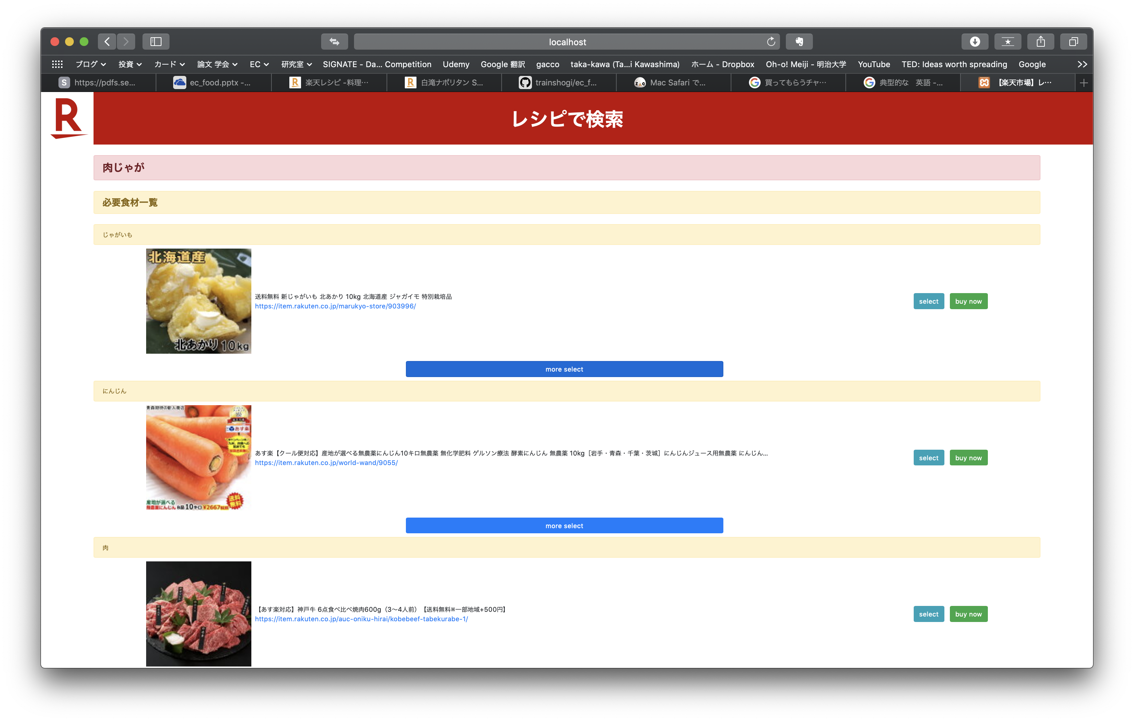
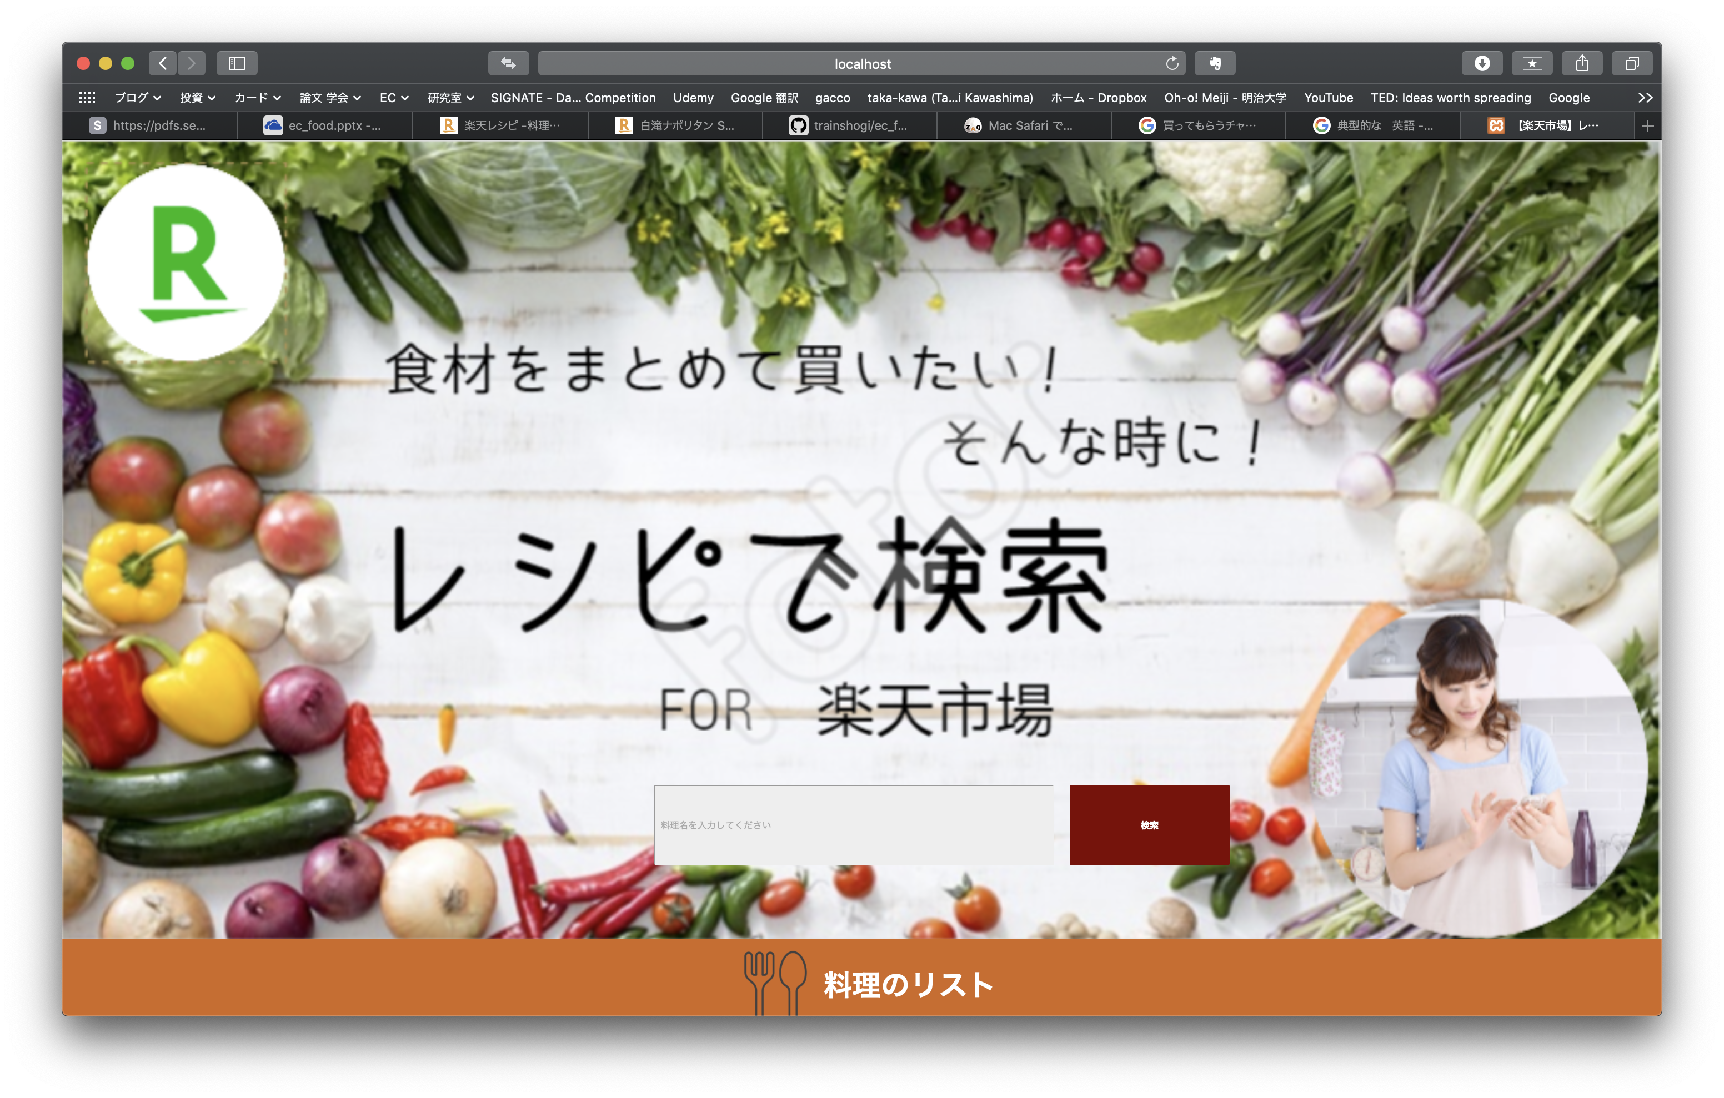

Function1 Rakuten recipe's URL
“meat”
“potato”
Scraping
URL
Request API
Search Result
Notes:
Next, I am going to explain about the two main functions of our system. The user can choose as an input, name of dish or URL of Rakuten recipe.
In case of being inputted URL of Rakuten recipe, our system get ingredients using scraping from rakuten recipe page. Then, using the information of ingredients, API provides a corresponded merchandise information.
By guiding from Rakuten recipe to Rakuten Ichiba, Rakuten will have more chance to be bought.
次に、私たちのシステムの主要機能二つについて説明します。ユーザは楽天レシピのURLまたは料理名を選択して入力することができます。
楽天レシピから直接楽天市場へ誘導しているので、競合サイトで買い物を行われる可能性が減少

Slide 9

Function2 Typical recipe
“curry”
get ingredients
“meat”
Request API
Search Result
“potato”
Notes:
When a dish name is inputted, our system bring list of ingredients for the dish from database. Then, same as function1, API provides a corresponded merchandise information.
This system is just prototype, the database has only imformation of two dishes and four ingredients.
To use practical, we have to prepare many kinds of information of dishes and ingredients.
今回のシステムはプロトタイプなので、データベースには料理２種、食材４種のデータしか入っていません。

Slide 10
Demo
Let's have a demo!

Slide 11
Experiment
Setup
The time from open rakuten recipe(Shirataki pasta) to put all ingredients in cart
10 ingredients
"Shirataki noodles","Chicken breast","Salt","Pepper","Onion"
"Carrot","Green pepper","Oil","Minched garic" "Tomato ketchup"
Who | Conventional | Our System | Speed up rate
N.I | 359s | 14s | ×25
A.S | 344s | 19s | ×18
T.K | 259s | 25s | ×10
S.Y | 288s | 26s | ×11
Average | 312.5s | 21s | ×16
Notes:
in the usual way Search for ingredients using Rakuten Ichiba
its more than 4 to 6 minutes
Our system is in the our way. Search for ingredients using our system
its less than a half of minutes
so speed up rate is an outstanding number
we focused on speed
so we were able to produce good result

Slide 12
Summary & improvements
From this solution...
Profit
User: Easy to buy ingredients for cooking
Rakuten: Increase the chance to buy in Rakuten
How do you want to make use of it after joining Rakuten ?
No connection between Rakuten services
It will be trigger to connect each service
Improvements
Parallel API calls
Cannot handle products with certain characteristics
Add sort function
Notes:
As I mentioned earlie
the topic of profit is スライド
the topic of How do you want to make use of it after joining Rakuten ?
No connection between Rakuten services for example Rakuten recipe listed ingredient but can't buy ingredient in rakuten ichiba directory.
スライド
we will be the arch. Rakuten Service and Rakuten Service.
the topic of improvement is スライド
we use direct API. 説明
so using long time.
if use pallarel API very faster.

Slide 13
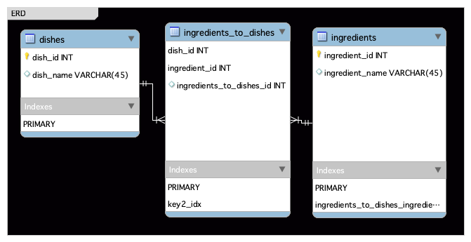
Abstract ~DB~
e.g.
Dish_id | Ingredient _id | Ingredients_to_dishes_id
1 | 1 | 1
1 | 2 | 2
2 | 1 | 3
2 | 2 | 4
2 | 3 | 5
Ingredient _id | Ingredient _name
1 | じゃがいも
2 | 肉
3 | カレールー
Dish_id | Dish_name
1 | 肉じゃが
2 | カレー

Slide 14
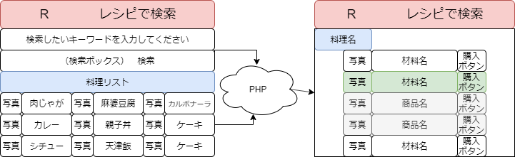
~Screen transition diagram~

